Slide 1
Degrees of Freedom and Robot Geometry
Prof. Shiraz Husain
Reference: Fundamentals of robotics analysis & control Robert J. Schilling Prentice-Hall of India (2003)

Slide 2
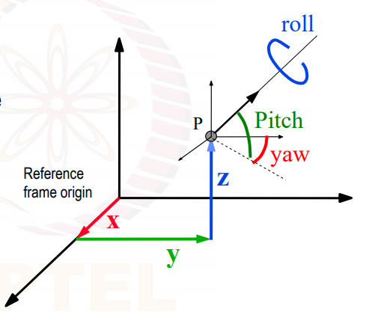
DOF
Positioning the end effector in the 3D space requires three DOF, either obtained from rotations or displacements
Orientation of the end effector in the 3D space requires three additional DOF to produce the three rotations.

Slide 3
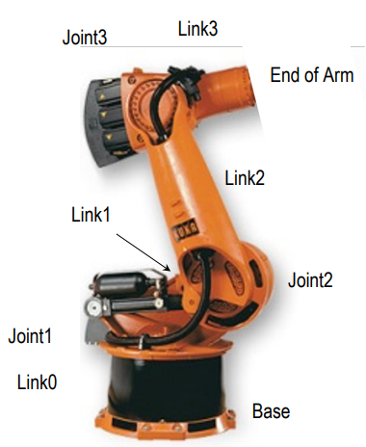
Robot anatomy
Manipulator consists of joints and links
Joints provide relative motion
Links are rigid members between the joints
There are six types of joints
Each joint provides certain degrees of freedom
Most robot possess five or six degrees of freedom
Robot manipulator consists of two sections
Body and arm assembly for positioning of objects in the robots work volume
Wrist assembly for orientation of objects

Slide 4
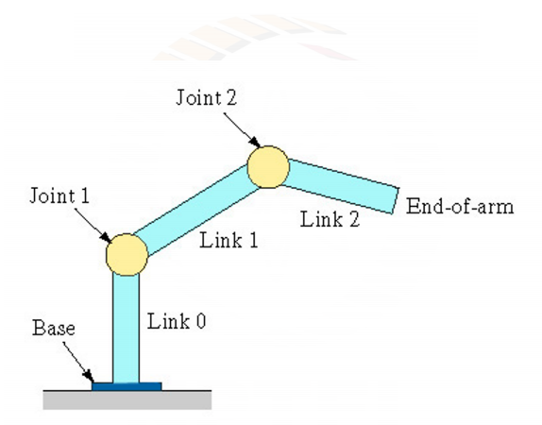
Robot Anatomy
Robot manipulator – a series of joint link combinations

Slide 5
Definition
Configuration is the specification of the position of all the points of a robot.
Degrees of Freedom is the dimension of the C-space or it is the minimum number of real numbers needed to represent the configuration.
Gross Work Envelope of a robot is defined as the locus of points in three dimensional space that can be reached by the wrist.
Workspace is the region of gross work envelope a robot can fully interact with. The workspace limitations are: Actuator end stroke, working range of joints, and collisions among manipulator’s link.

Slide 6
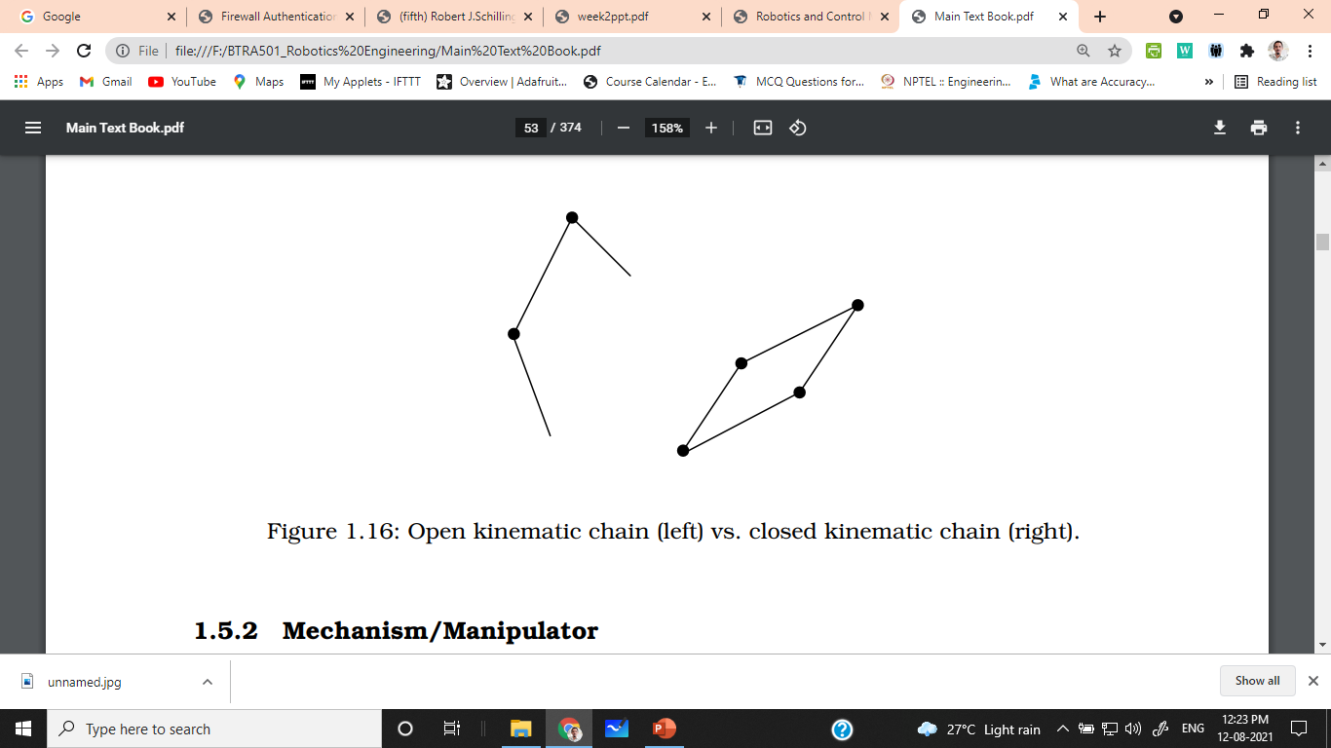
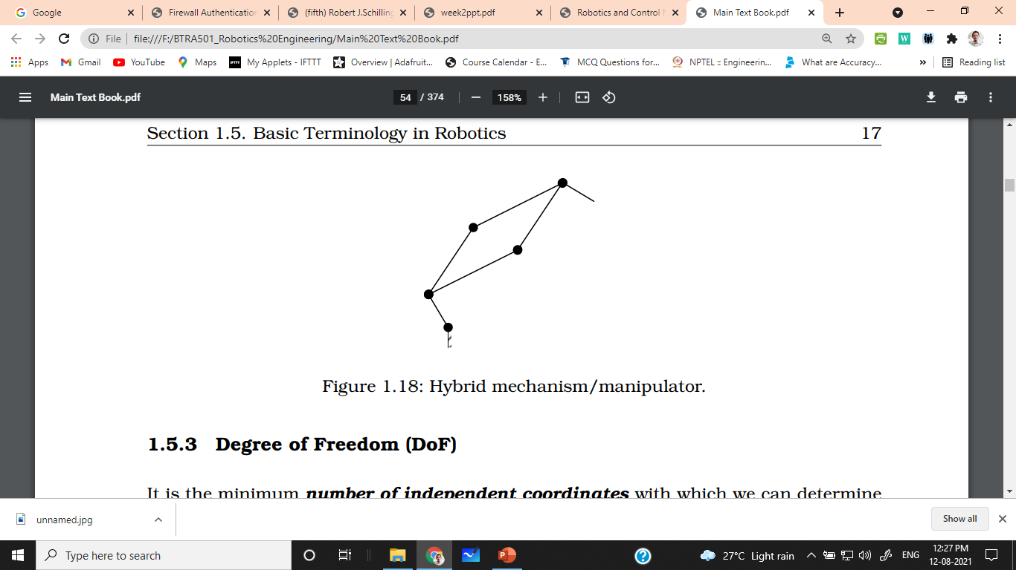
Definition
A Kinematic Chain is a collection of elements, bodies, bonds, and links interconnected by joints.
Open Chain when the last link is not connected to the first link.
Closed Chain when the last link is connected to the first link
A mechanism is a kinematic chain in which one of the links is fixed. This link is the reference for the remaining links. A manipulator/arm is a mechanism.
Serial manipulator a mechanism based on an open kinematic chain.
Parallel manipulator a mechanism based on a closed kinematic chain.
Hybrid manipulators are combination of parallel and serial manipulators

Slide 7
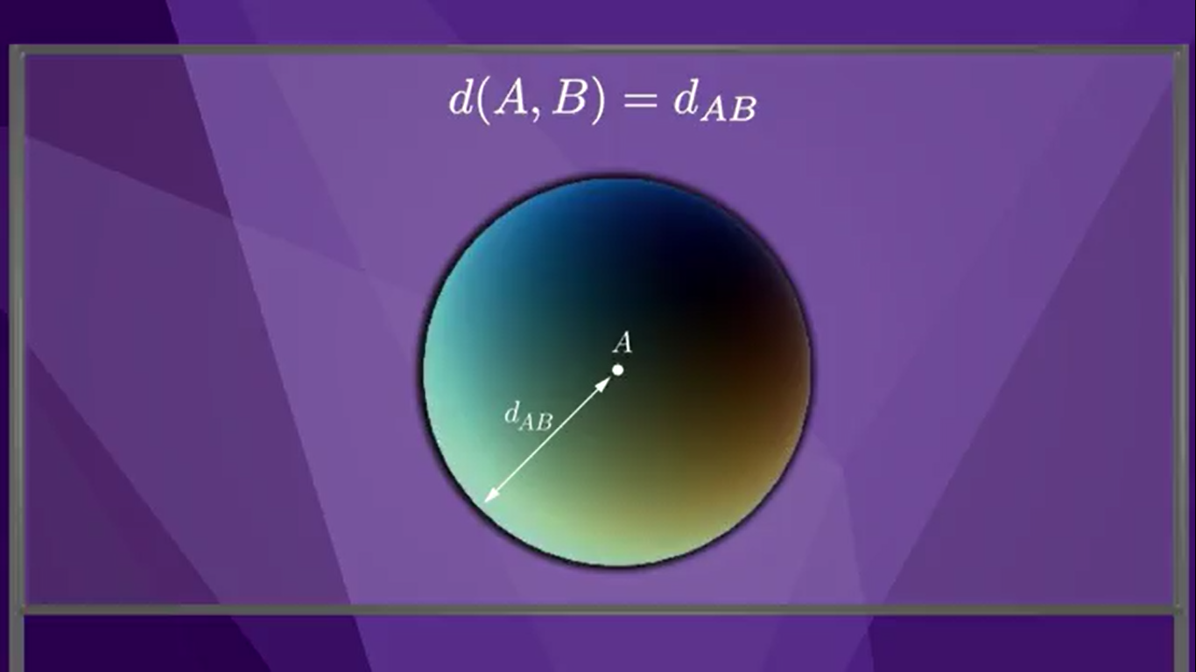
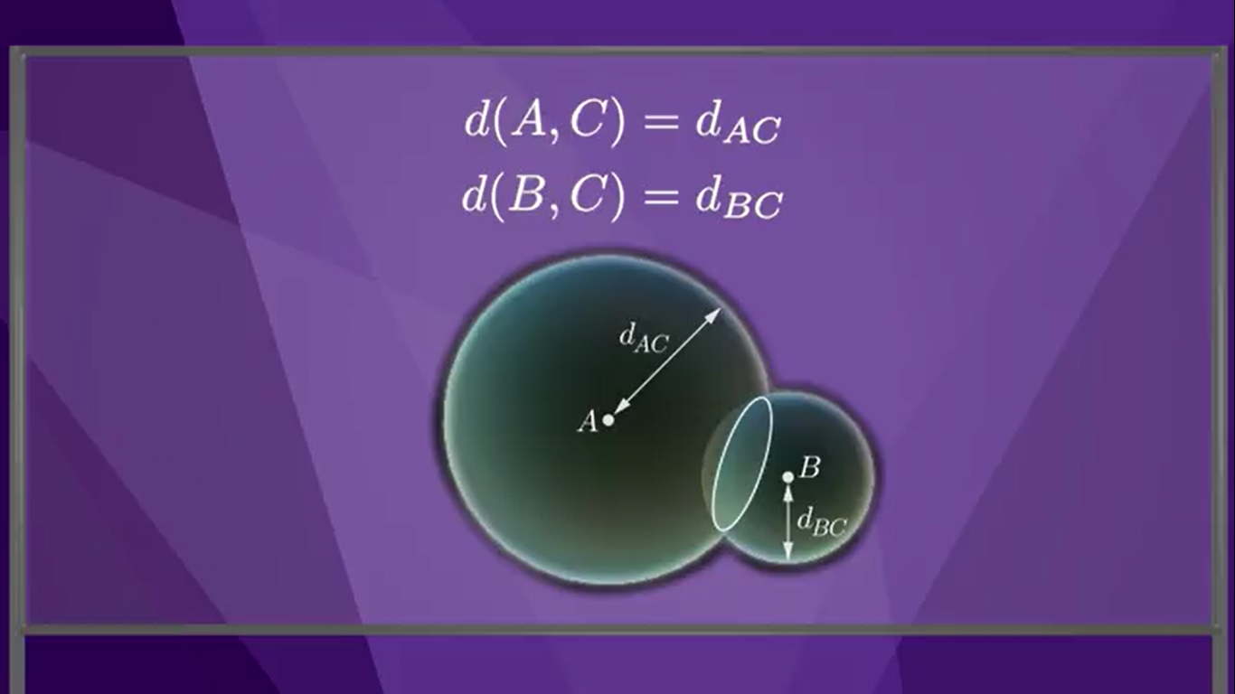
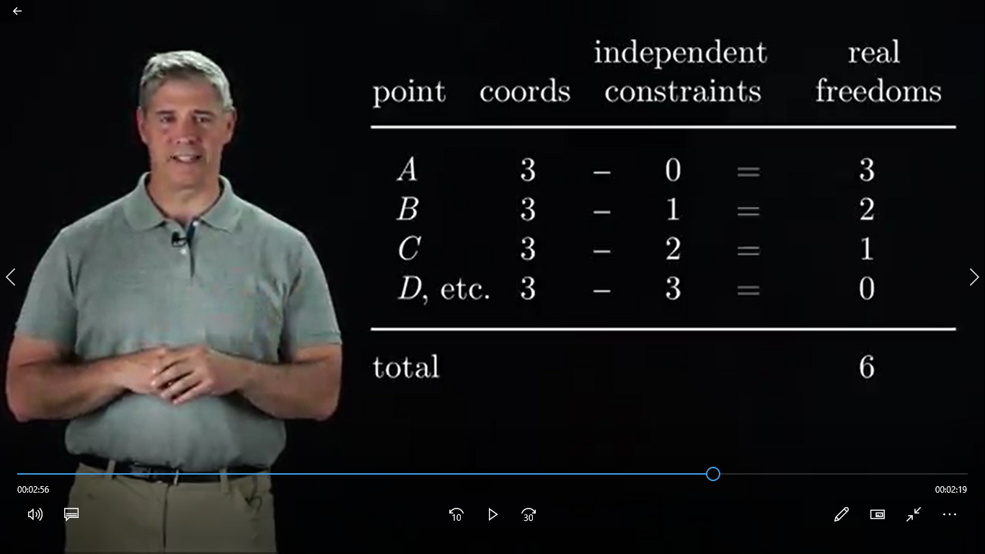
Rigid Body / Links
Rigid body has 6 degrees of freedom

Slide 8
DOF
Dimension of C-Space | Linear | Angular | DOF
2 | 2 | 1 | 3
3 | 3 | 3 | 6
4 | 4 | 6 | 10
For a 3-D space, the rigid body has 6 degrees of freedom which includes linear movements like x, y, and z and other 3 are angles i.e. roll, pitch, and yaw.

Slide 9
Calculation of DOF
DOF = ∑(Freedom of points) – Number of independent constraints.
Since robots is made of rigid bodies, the constraints on motion often come from joint.

Slide 10
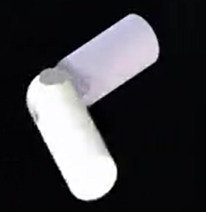
Revolute Joint
Constraints : 5
Freedom : 1

Slide 11
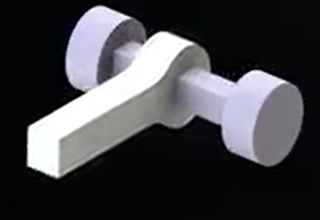
Prismatic Joint
Constraints : 5
Freedom : 1

Slide 12
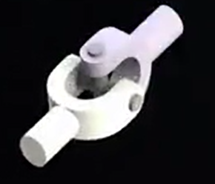
Universal Joint
Constraints : 4
Freedom : 2

Slide 13
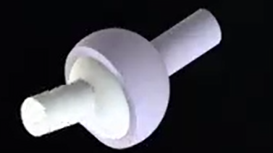
Spherical Joint
Constraints : 3
Freedom : 3

Slide 14
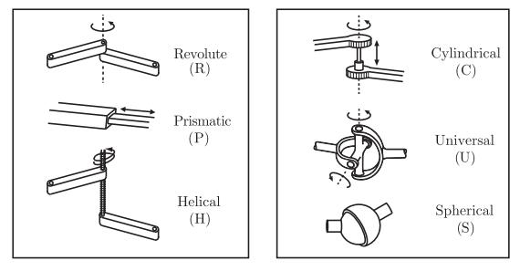
Summary of Joints

Slide 15
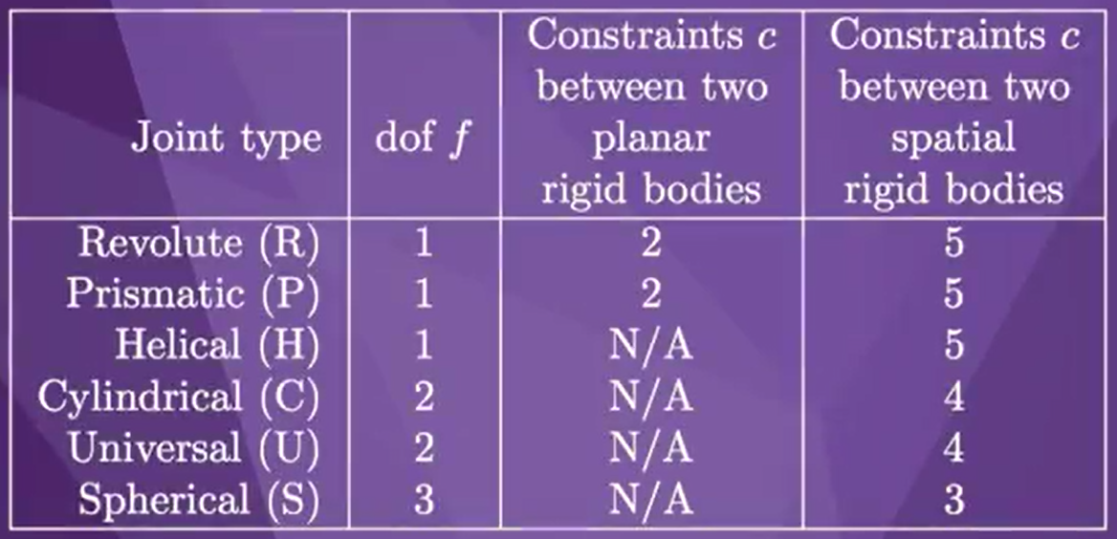
Summary

Slide 16
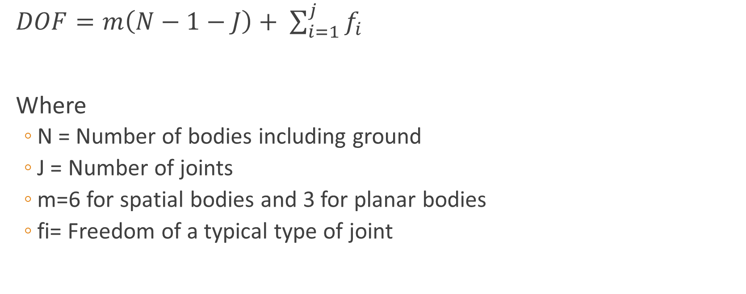
Grubler’s Formula
$DOF=m\left(N−1−J\right)+ \sum_{i=1}^{j}{f_{i}}$
Where
N = Number of bodies including ground
J = Number of joints
m=6 for spatial bodies and 3 for planar bodies
fi= Freedom of a typical type of joint

Slide 17
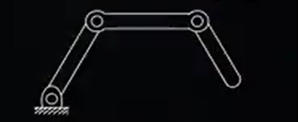
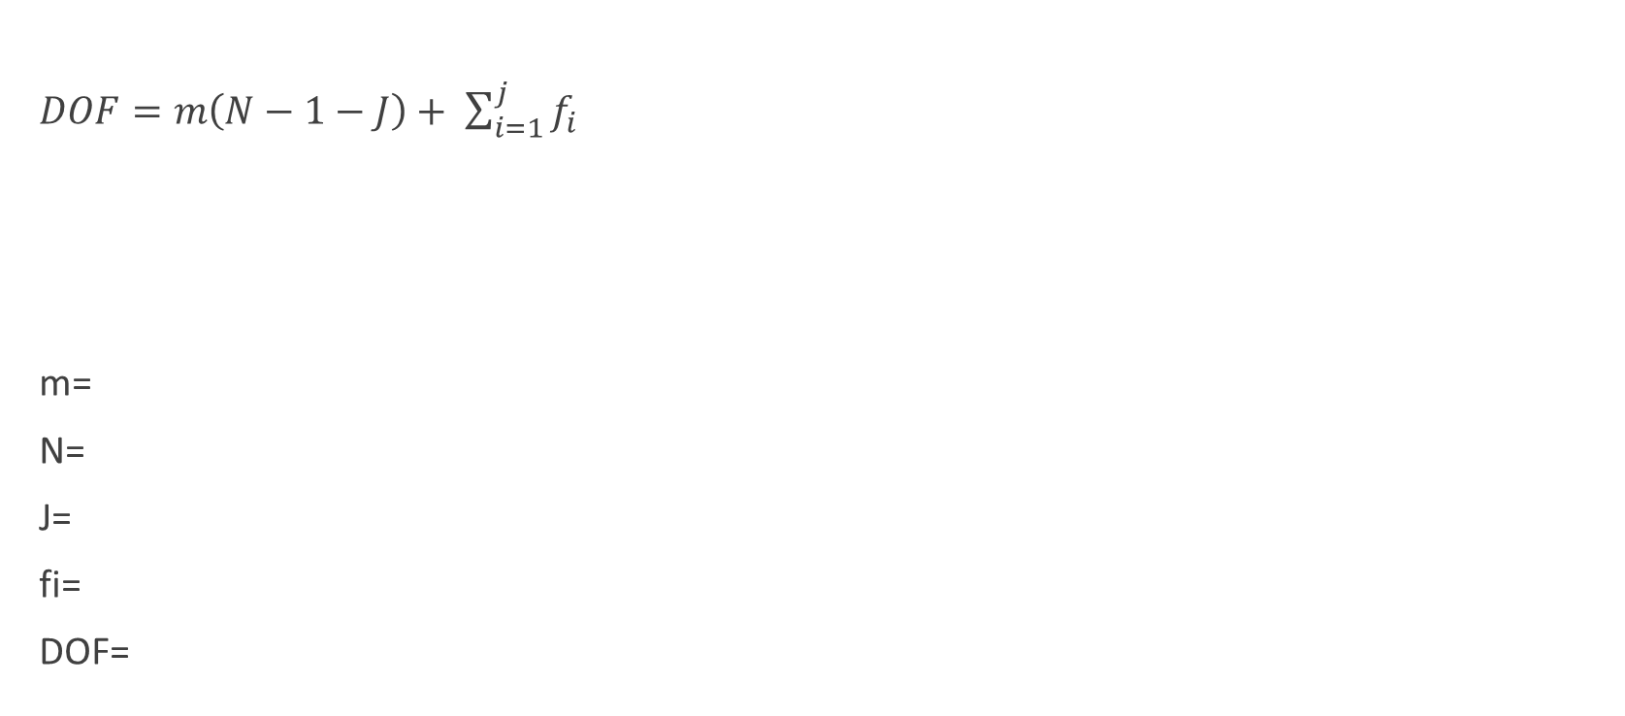
Example 1: 3R Open serial chain robot
$DOF=m\left(N−1−J\right)+ \sum_{i=1}^{j}{f_{i}}$
m=
N=
J=
fi=
DOF=

Slide 18
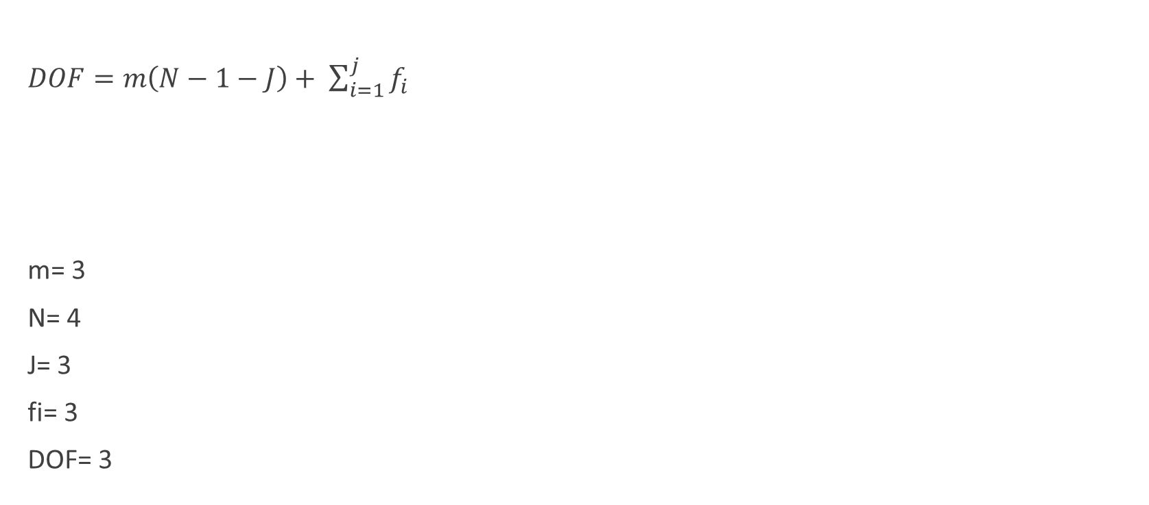
Example 1: 3R Open serial chain robot
$DOF=m\left(N−1−J\right)+ \sum_{i=1}^{j}{f_{i}}$
m= 3
N= 4
J= 3
fi= 3
DOF= 3

Slide 19
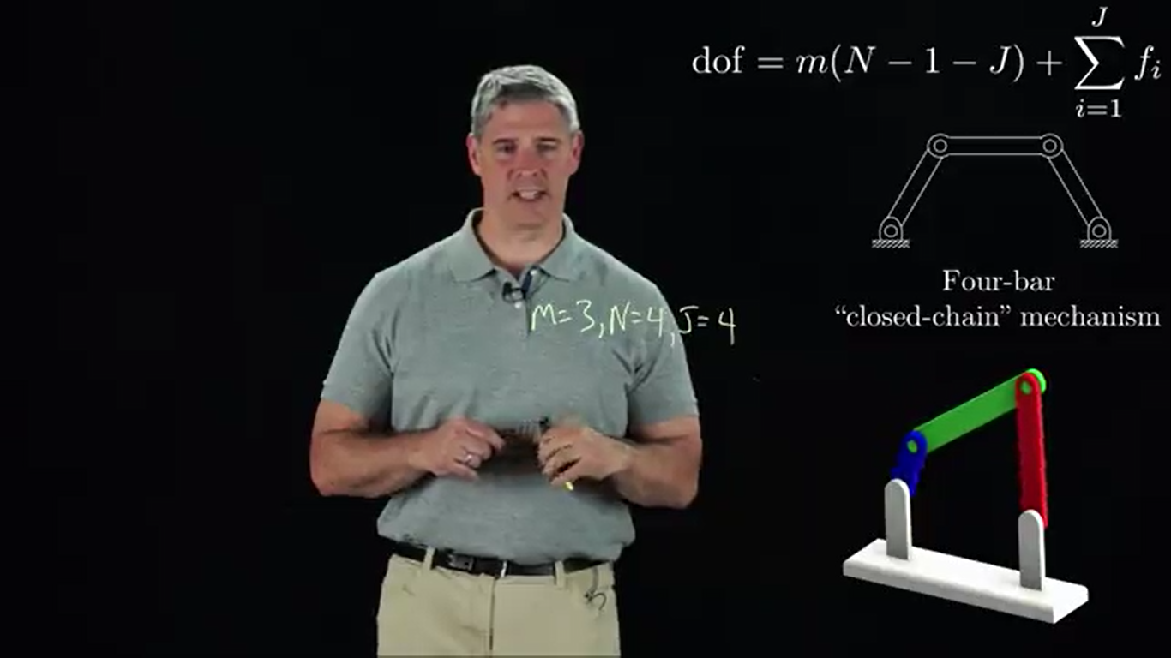
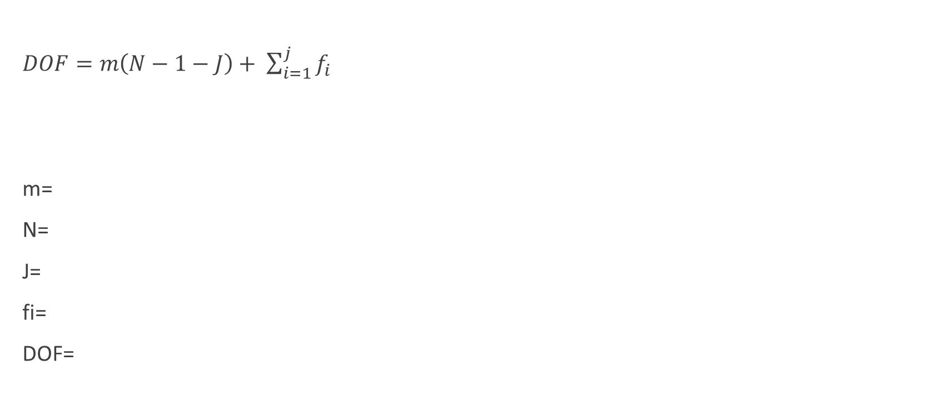
Example 2: 4-bar Closed Chain Mechanism
$DOF=m\left(N−1−J\right)+ \sum_{i=1}^{j}{f_{i}}$
m=
N=
J=
fi=
DOF=

Slide 20
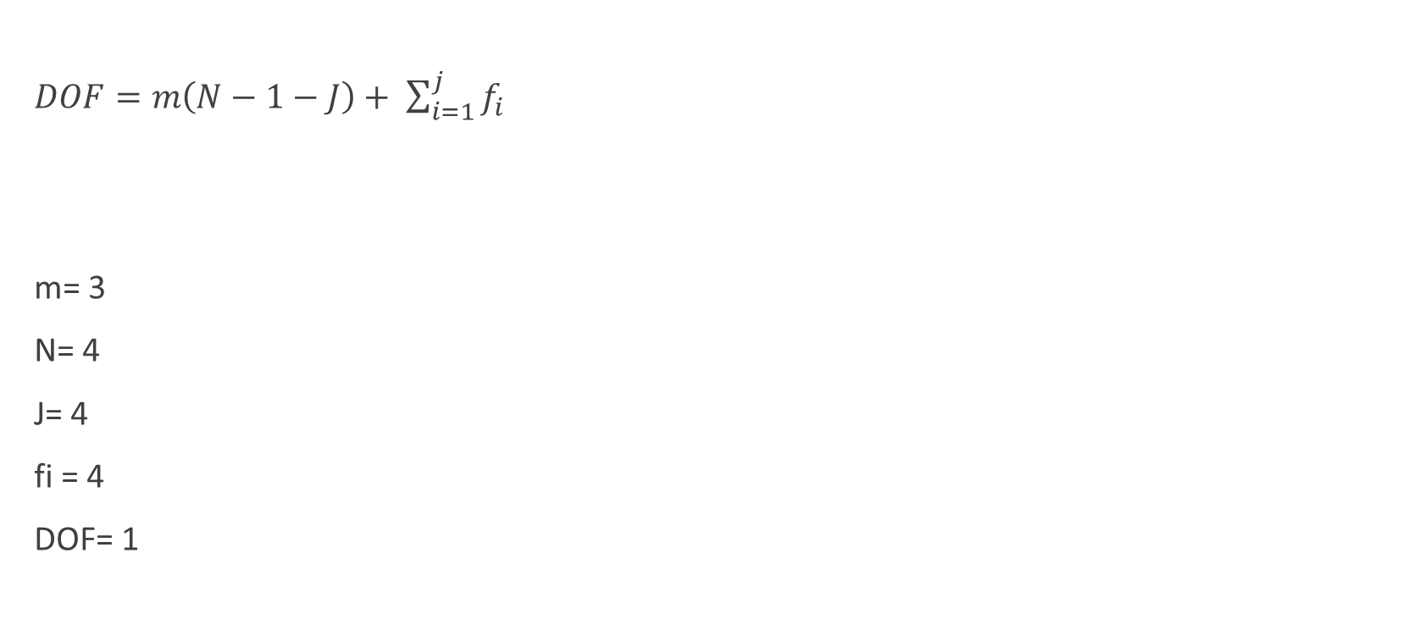
Example 2: 4-bar Closed Chain Mechanism
$DOF=m\left(N−1−J\right)+ \sum_{i=1}^{j}{f_{i}}$
m= 3
N= 4
J= 4
fi = 4
DOF= 1

Slide 21
Robot Geometry
Robot architecture is the combination and disposition of the different kind of joints that configure the robot kinematical chain. There are two different robot Geometry Serial Geometry and Parallel Geometry:
■ Five common body-and-arm configurations for Serial Geometry industrial robots are:
Polar coordinate body-and-arm assembly
Cylindrical body-and-arm assembly
Cartesian coordinate body-and-arm assembly
Jointed-arm body-and-arm assembly
Selective Compliance Assembly Robot Arm (SCARA)
■ Function of body-and-arm assembly is to position an end effector (e.g., gripper, tool) in space

Slide 22
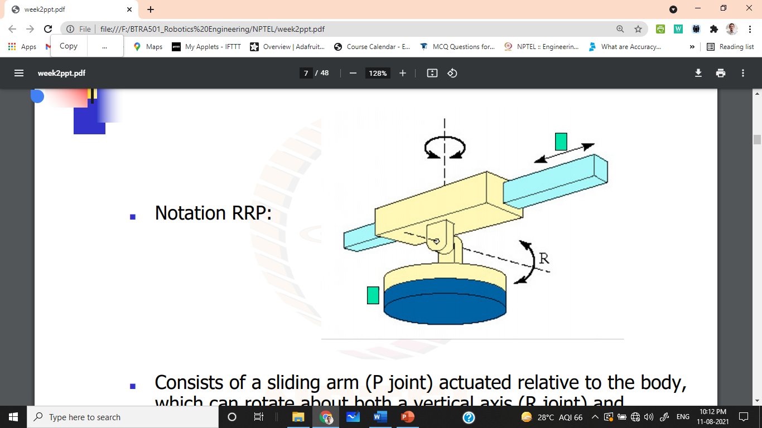
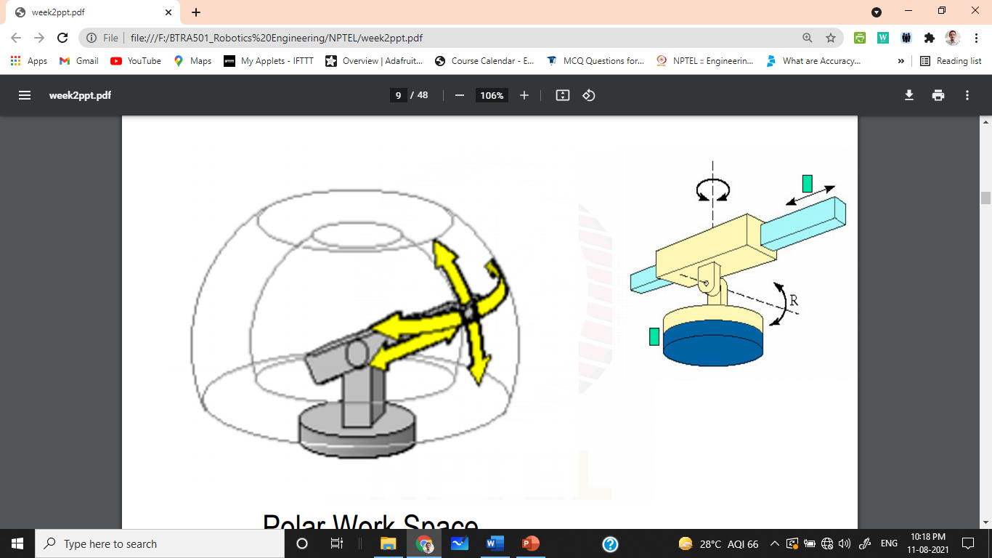
Polar Body and Arm Assembly
Notation: RRP
Consists of a sliding arm (P joint) actuated relative to the body, which can rotate about both a vertical axis (R joint) and horizontal axis (R joint)
Advantages:
Large reach from a central support
It can bend to reach objects on the floor
Motors 1 and 2 close to the base
Disadvantages:
Complex kinematics model
Difficult to visualize

Slide 23
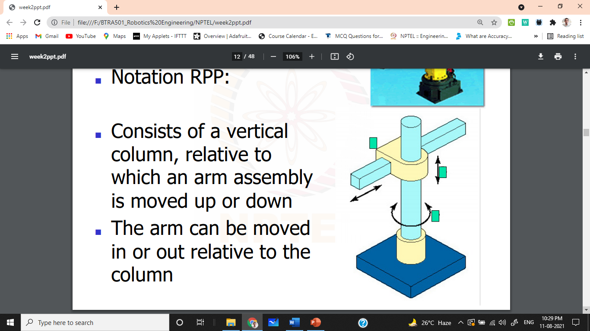
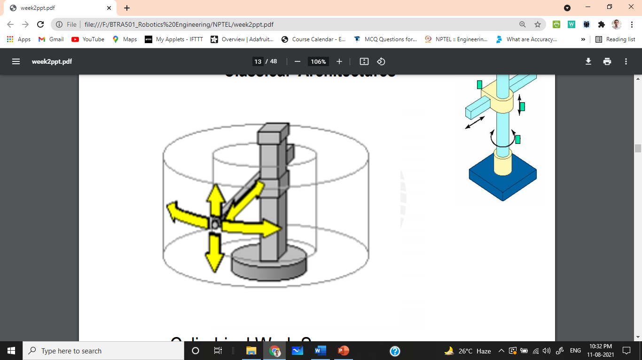
Cylindrical Body and Arm Assembly
Notation: RPP
Consists of a vertical column, relative to which an arm assembly is moved up or down
The arm can be moved in or out relative to the column
Advantages:
simple kinematical model
easy to display
good accessibility to cavities and open machines
large forces when using hydraulic actuators
Limitations:
restricted working volume
requires guides protection (linear)

Slide 24
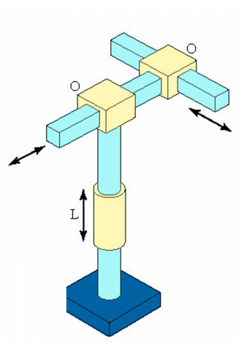
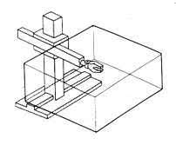
Cartesian Coordinate Body and Arm Assembly
Notation: PPP
Consists of 3 sliding joints, other names include rectilinear robot x, y and z
Advantages:
linear movement in three dimensions with constant resolution
simple kinematical model, rigid structure and easy to display
possibility of using pneumatic actuators, which are cheap, in pick & place operations.
Limitations:
requires a large working volume
the working volume is smaller than the robot volume (crane structure)
requires free area between the robot and the object to manipulate
guides protection

Slide 25
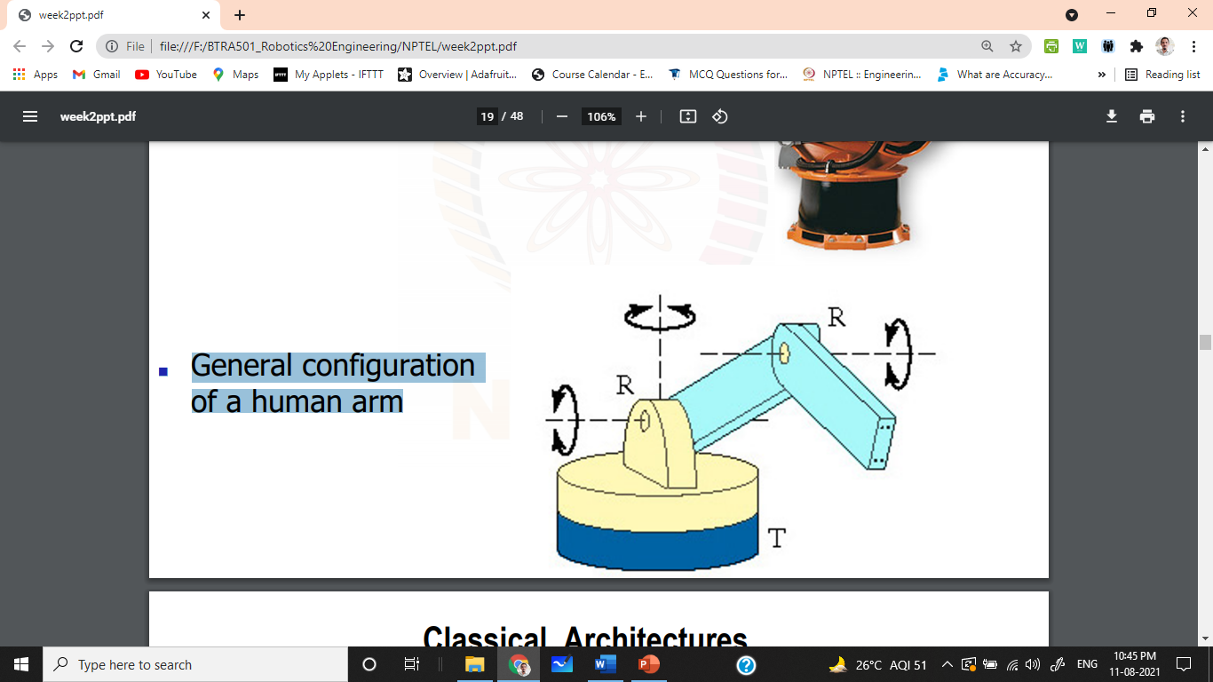
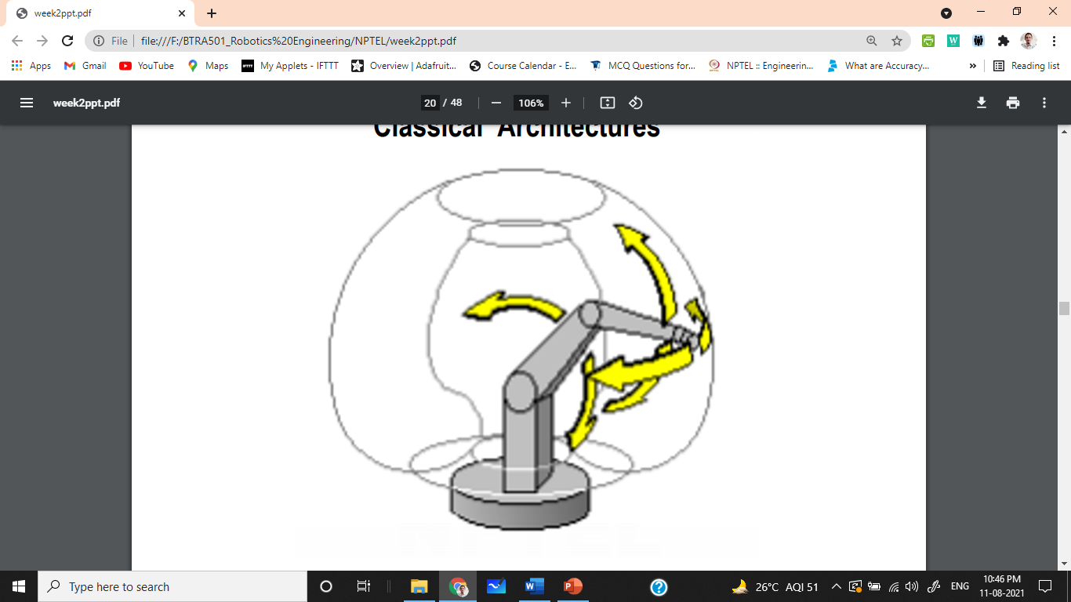
Jointed Body and Arm Assembly
Notation: RRR
General configuration of human arm. Has angular workspace.
Advantages:
maximum flexibility
large working volume with respect to the robot size
joints easy to protect (angular)
can reach the upper and lower side of an object
Limitations:
complex kinematical model
linear movements are difficult
no rigid structure when stretched

Slide 26
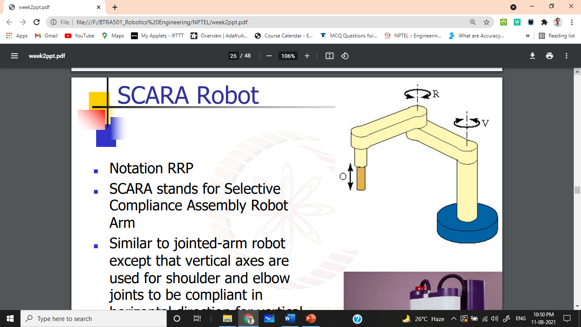
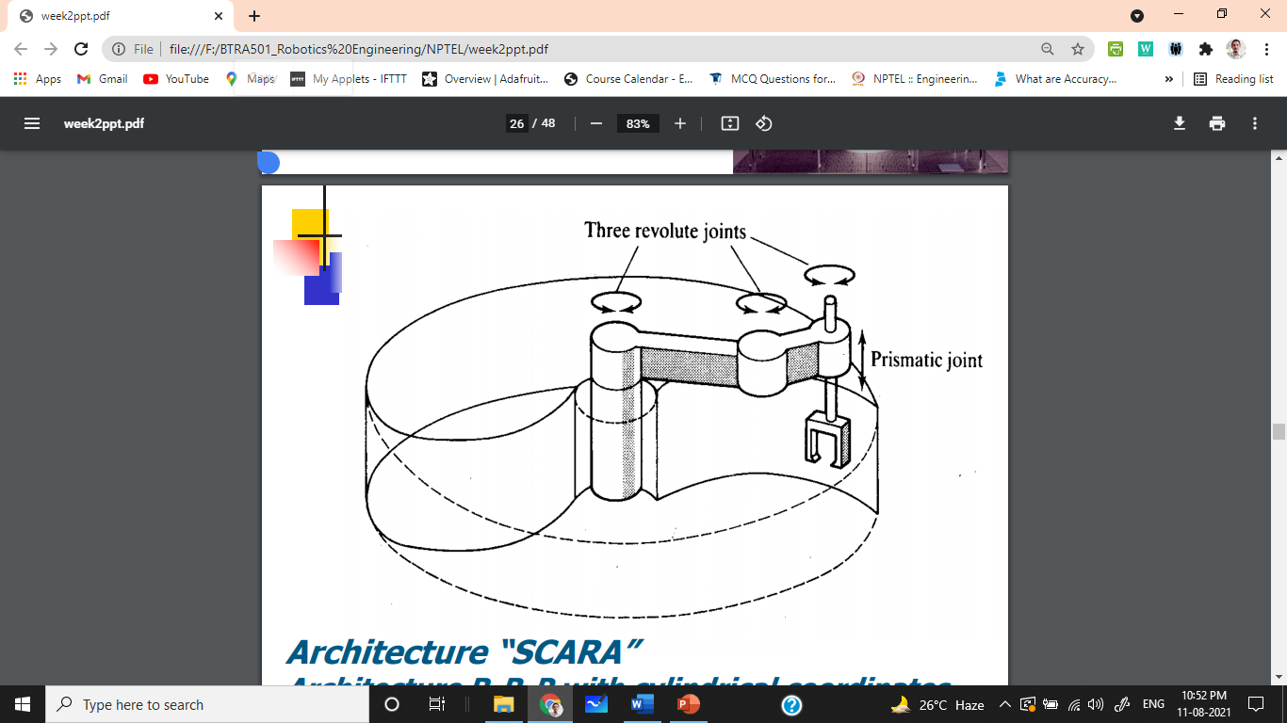
SCARA
Notation: RRP
SCARA stands for Selective Compliance Assembly Robot Arm Like jointed-arm robot except that vertical axes are used for shoulder and elbow joints to be compliant in horizontal direction for vertical insertion tasks
Advantages:
High speed and precision
Limitations:
Only vertical axis

Slide 27
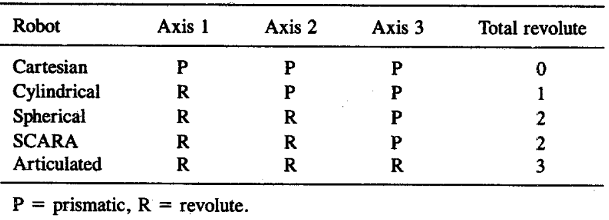
Robot work envelopes based on major axes

Slide 28
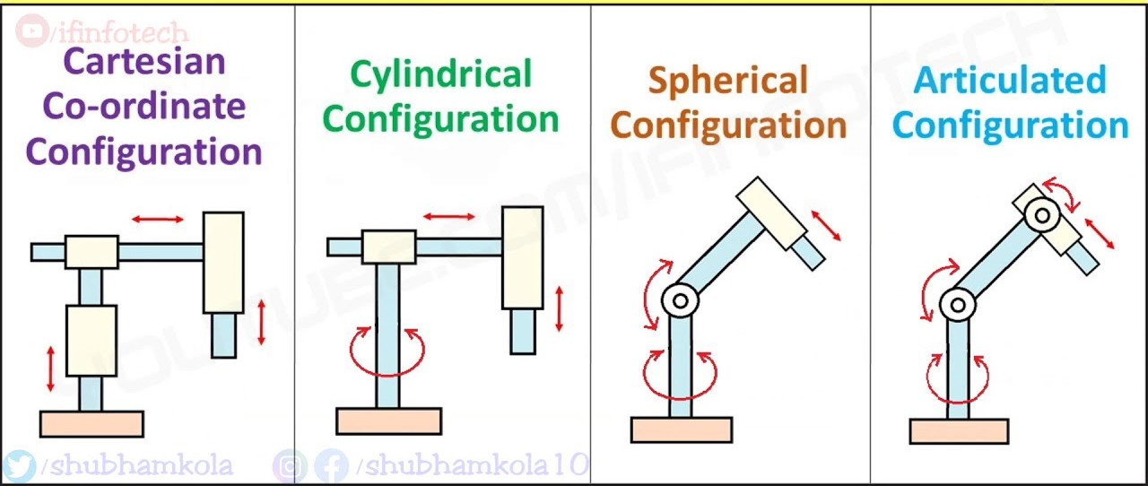
Kinematic Structure

Slide 29
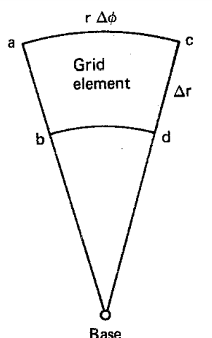
Precision in Robot Configuration
Robot Type | Horizontal Precision | Vertical Precision
Cartesian | Uniform | Uniform
Cylindrical | Decreases radially | Uniform
Spherical | Decreases radially | Decreases radially
SCARA | Varies | Uniform
Articulated | Varies | Varies

Slide 30
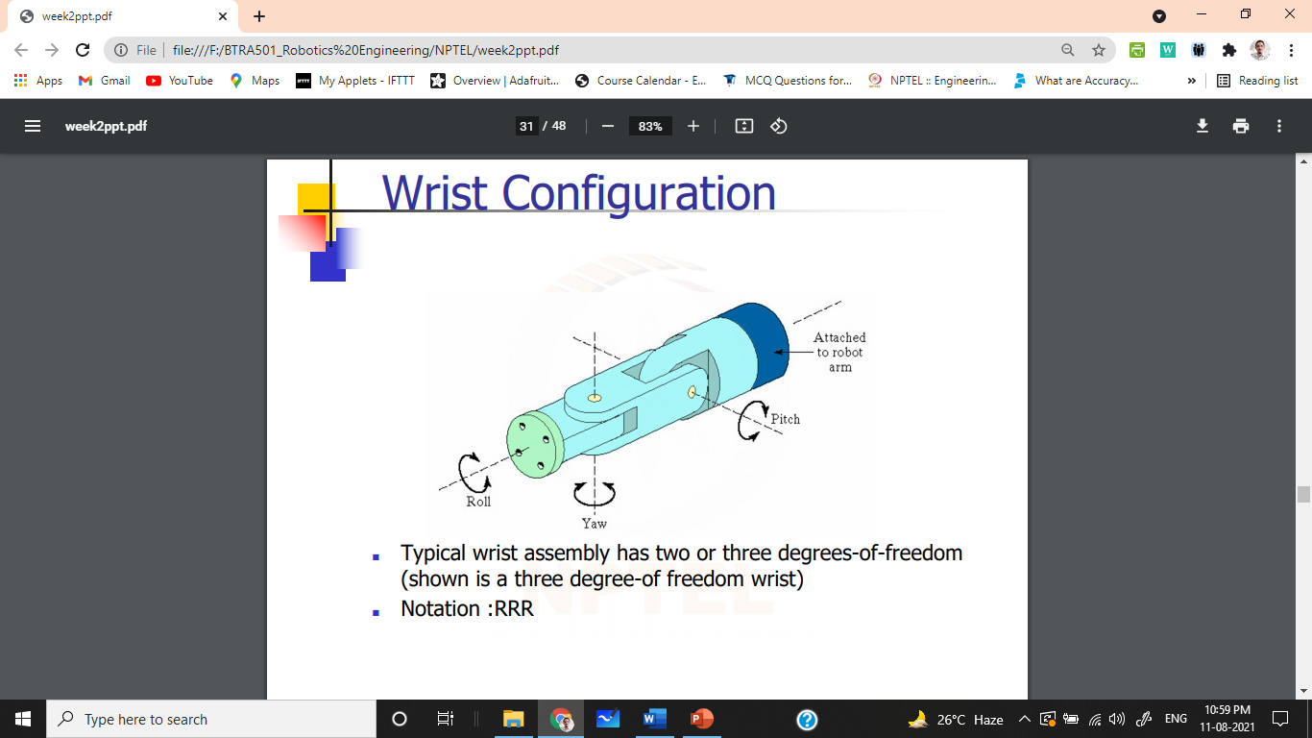
Wrist Configuration
Wrist assembly is attached to end-of-arm
End effector is attached to wrist assembly
Function of wrist assembly is to orient end effector
Body-and-arm determines global position of end effector
Typical wrist has 2 or 3 DOF
Notation : RRR

Slide 31
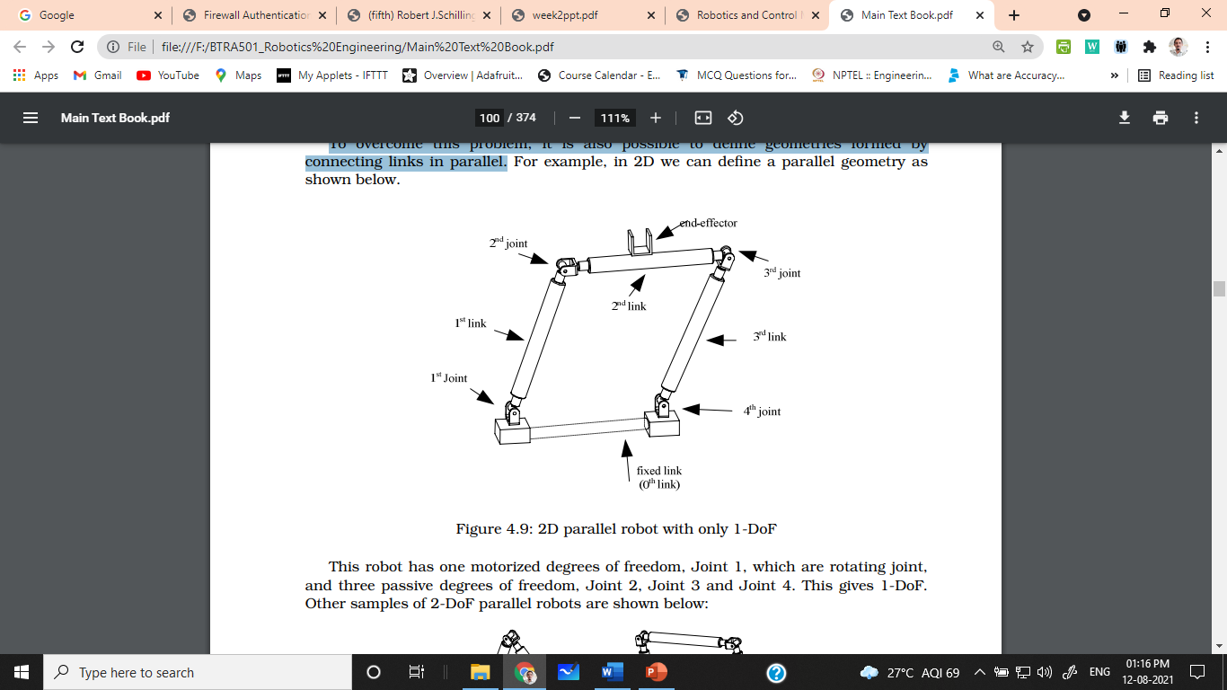
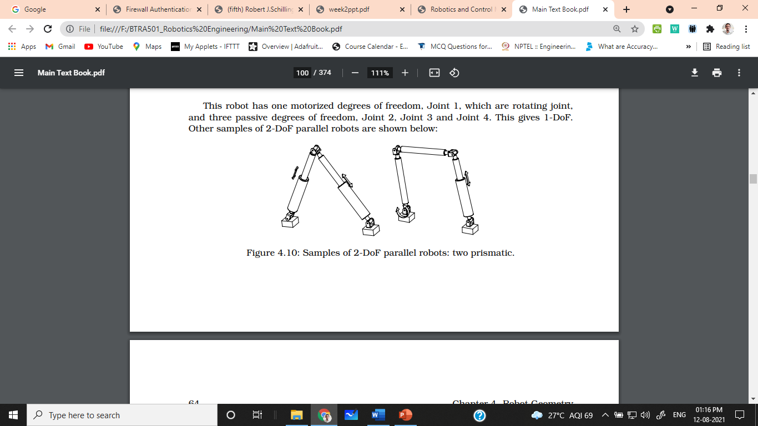
Parallel Geometry
Serial manipulators usually have big workspaces with great dexterity. However, their load capacity is quite small. To overcome this problem, it is also possible to define geometries formed by connecting links in parallel.

Slide 32
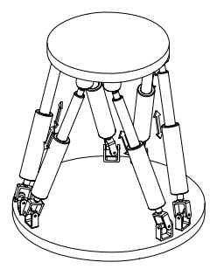
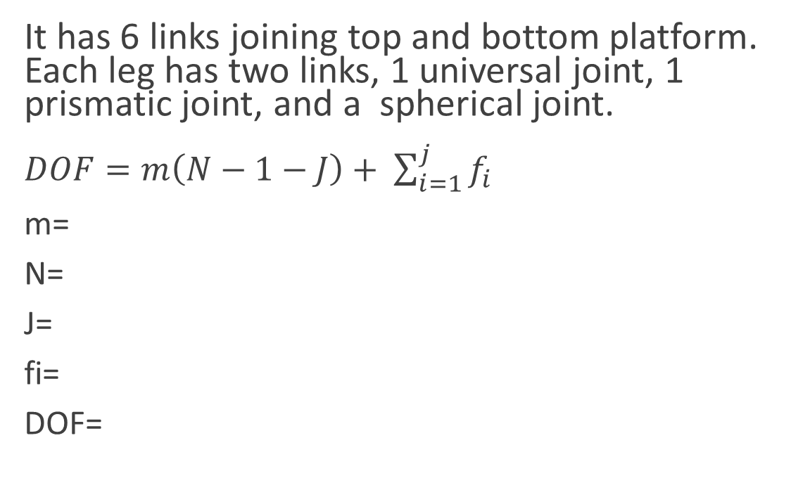
Stewart Platform
It has 6 links joining top and bottom platform. Each leg has two links, 1 universal joint, 1 prismatic joint, and a spherical joint.
$DOF=m\left(N−1−J\right)+ \sum_{i=1}^{j}{f_{i}}$
m=
N=
J=
fi=
DOF=

Slide 33
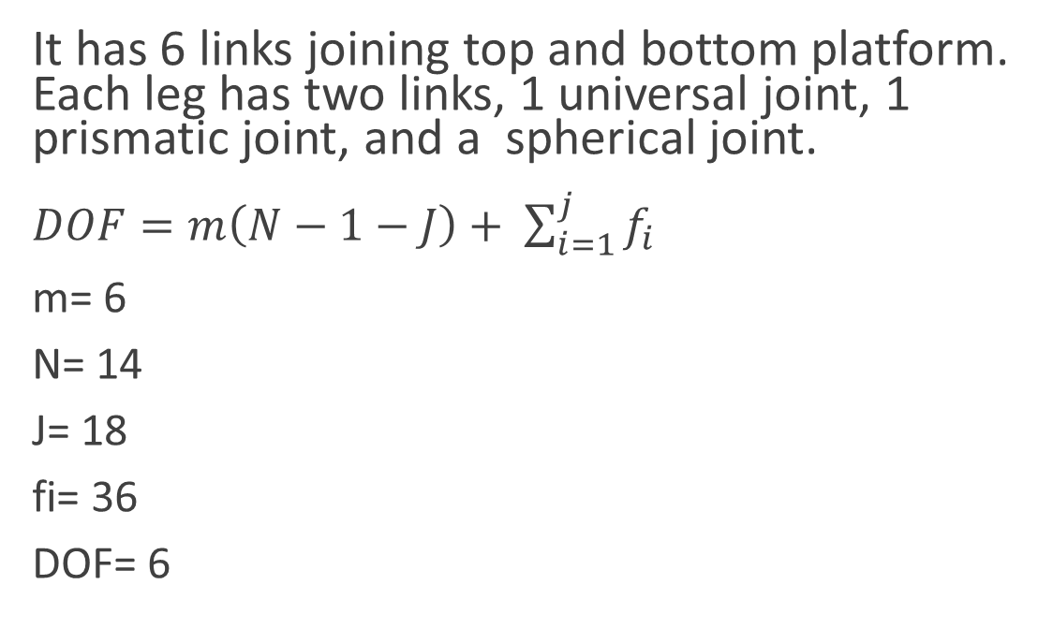
Stewart Platform
It has 6 links joining top and bottom platform. Each leg has two links, 1 universal joint, 1 prismatic joint, and a spherical joint.
$DOF=m\left(N−1−J\right)+ \sum_{i=1}^{j}{f_{i}}$
m= 6
N= 14
J= 18
fi= 36
DOF= 6

Slide 34
End Effectors
End Effector is a special tooling for a robot that enables it to perform a specific task. They may be of two types:
Grippers – to grasp and manipulate objects (e.g., parts) during work cycle
Tools – to perform a process, e.g., spot welding, spray painting
Human arm is a versatile gripper.
An end effector has interchange ability unlike human hand.

Slide 35
Grippers
Grippers are the end effectors used for holding the parts or objects
They include mechanical hands and also anything like hooks, magnets and suction devices which can be used for holding or gripping.
Grippers take advantage of point-to-point control. Grippers are designed in a manner that they require minimum amount of maneuvering in order to grip the work piece.
Applications of grippers :- Machine Loading and unloading, picking and placing of parts on conveyor, material handling, bottle handling, arranging parts onto pallets, etc.

Slide 36
Types of Grippers
1. Mechanical Grippers
2. Hooks and Scoops
3. Magnetics Grippers
4. Vacuum Grippers
5. Expandable Bladder Type Grippers
6. Adhesive Grippers

Slide 37
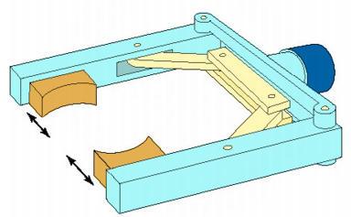
Mechanical Grippers
Mechanical Robots are like robot hands with 2 or 3 fingers.
They wrap around an object and rely on friction to secure the object it is holding. Friction between the gripper and the object will depend on two things,
Type of surface whether it be metal on metal, rubber on metal, smooth surfaces or rough surfaces
The force which is pressing the surfaces together.
Mechanical grippers are often fitted with some type of pad usually made from polyurethane as this provides greater friction. Pads are less likely to damage the work piece.
Mechanical grippers can be designed and made for specific purposes and adjusted according to the size of the object. They can also have dual grippers.

Slide 38
Hooks and Scoops
Hooks
A hook is needed to lift a part especially if precise positioning in not required and if it is only to be dipped into a liquid.
Hook are used to load and unload parts hanging from the overhead conveyors. The parts to be handled by a hook must have some sort of handle, eyebolt or ring to enable the hook to hold it.
Scoop
A scoop or ladle is commonly used to scoop up molten metal and transfer it to the mould.
Scoops are used for handling the materials in liquid from, the limitation of scoop is, it is difficult to control the amount of material being handled by the scoop. In addition, spilling of the material during handling is another problem.

Slide 39
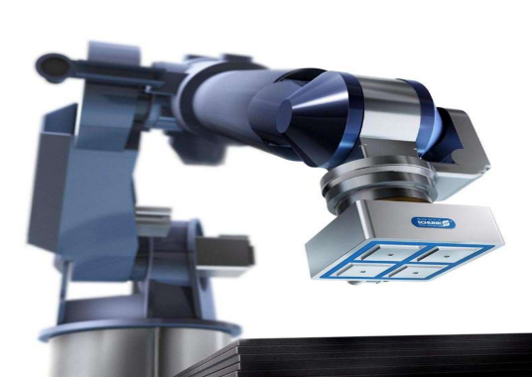
Magnetic Grippers
Magnetic grippers are limited in working with certain metals.
For maximum effect the magnet needs to have complete contact with the surface of the metal to be gripped. Any air gaps will reduce the strength of the magnetic force, therefore flat sheets of metal are best suited to magnetic grippers. If the magnet is strong enough, a magnetic gripper can pick up an irregular shaped object.
Permanent magnets tend to become demagnetized when heated and so there is the danger that prolonged contact with a hot work piece will weaken them to the point where they can no longer be used. The effect of heat will depend on the time the magnet spends in contact with the hot part. Most magnetic materials are relatively unaffected by temperatures up to around 100 degrees.
Electromagnets can be used instead and are operated by a DC electric current and lose nearly all of their magnetism when the power is turned off.
Permanent magnets are also used in situations where there is an explosive atmosphere and sparks from electrical equipment would cause a hazard.

Slide 40
Suction Grippers
There are two types of suction grippers:
Devices operated by a vacuum – the vacuum may be provided by a vacuum pump or by compressed air
Devices with a flexible suction cup – this cup presses on the work piece. Compressed air is blown into the suction cup to release the work piece. The advantage of the suction cup is that if there is a power failure it will still work as the work piece will not fall down. The disadvantage of the suction cup is that they only work on clean, smooth surfaces.

Slide 41
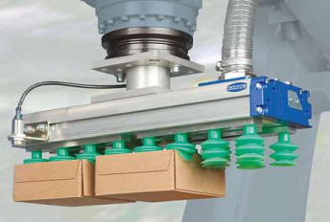
Suction Grippers
There are many more advantages for using a suction cup rather than a mechanical grip including: there is no danger of crushing fragile objects, the exact shape and size does not matter and the suction cup does not have to be precisely positioned on the object.
The downfalls of suction cups as an end effector include: the robot system must include a form of pump for air and the level of noise can cause annoyance in some circumstances

Slide 42
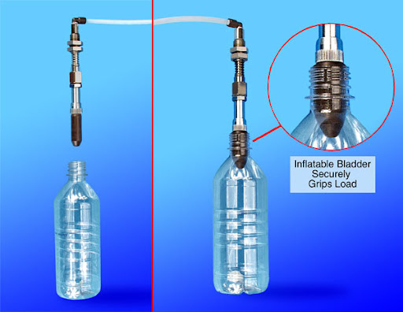
Expandable Bladder Type Grippers
A bladder gripper can be used to grasp, pick up, and move rod-shaped or cylindrical objects. The main element of the gripper is an inflatable, donut-shaped or cylindrical sleeve that resembles the cuff commonly used in blood pressure measuring apparatus.
The sleeve is positioned so it surrounds the object to be gripped, and then the sleeve is inflated until it is tight enough to accomplish the desired task.
The pressure exerted by the sleeve can be measured and regulated using force sensors.
Bladder grippers are useful in handling fragile objects. However, they do not operate fast, and they can function only with objects within a rather narrow range of physical sizes.

Slide 43
Adhesive Grippers
Adhesive Substance can be used for grasping action in adhesive grippers.
In adhesive grippers, the adhesive substance losses its tackiness due to repeated usage. This reduces the reliability of the gripper. In order to overcome this difficulty, the adhesive material is continuously fed to the gripper in the form of ribbon by feeding mechanism.
A major asset of the adhesive gripper is the fact that it is simple. As long as the adhesive keep its stickiness it will continue to function without maintenance, however, there are certain limitations, the most significant is the fact that the adhesive cannot readily be disabled in order to release the grasp on an object. Some other means, such as devices that lock the gripped object into place, must be used.
The adhesive grippers are used for handling fabrics and other lightweight materials.

